Slide 1

Design and development of fully automated biaxial stretching mechanism for dielectric elastomers
B.TECH PROJECT END-EVALUATION
Guided by :
Presented by :
Dr. Aman Khurana
Assisstant Professor
Department of Mechanical Engineering
IIT Indore
Pranshu Devlia - 230003052
Jitesh K. Meena - 230003030

Slide 2
CONTENT :
o
  Introduction
  Significance of Pre-stretch
  Existing Mechanisms
  Objective
  Work Done
  Design and Measurements
  Hardware Components
  Block and Circuit Diagram
  Future Work

Slide 3
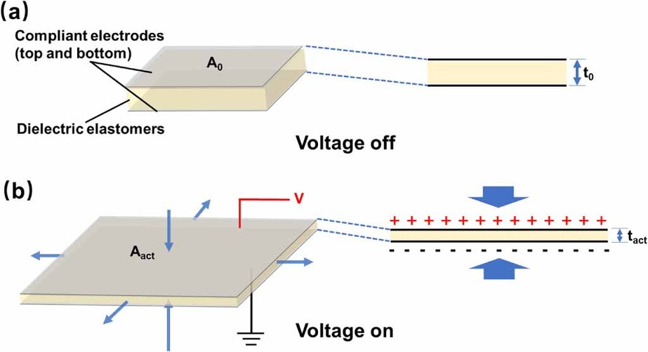

INTRODUCTION : DIELECTRIC ELASTOMERS
Properties :
  Large deformations
  Efficient Electromechanical coupling
  Soft, flexible & lightweight
Maxwell stress
At excessive thinning excessive electric field
further thinning
↓
Positive Feedback Loop
↓
EMI → rapid unstable thinning → electrical breakdown
Challenege :
Applications :
Actuators • Sensors • Energy Harvesters • Haptic Devices • Acoustic Transducers • Pneumatic Valves • Wearable Systems • Power Generators • Soft Robotics

Slide 4
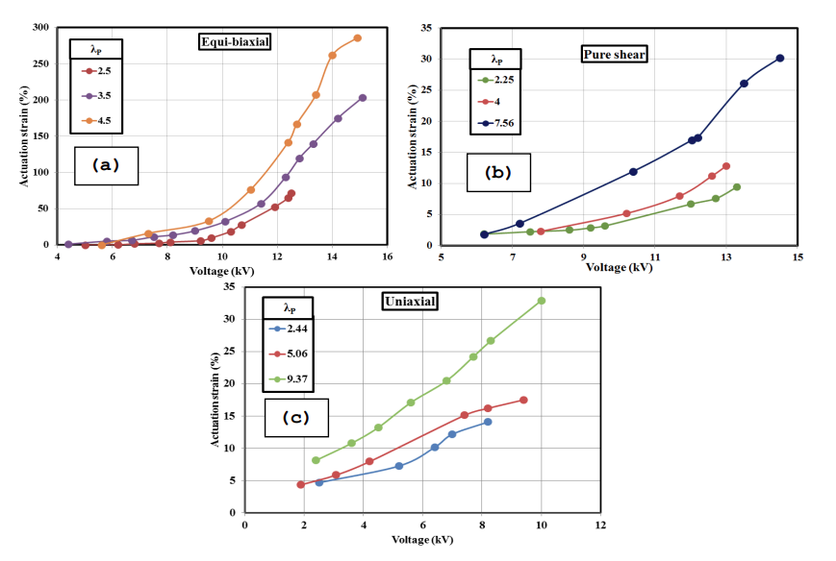
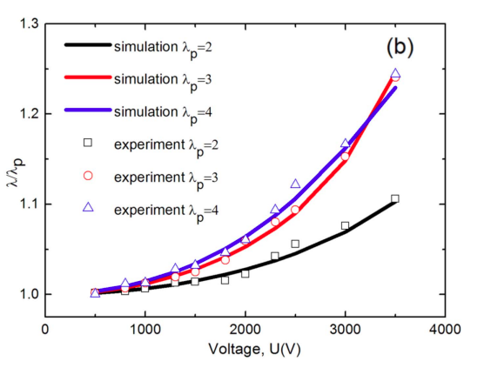
SIGNIFICANCE OF PRE-STRETCH :
  Strain Stiffening
  Suppresses EMI
  Greater Actuation Range
  Lower Voltage requirements
Equi-biaxial
Actuation Ratio v/s Voltage at different pre-stretches & different stretching modes. [4.],[5.]

Slide 5
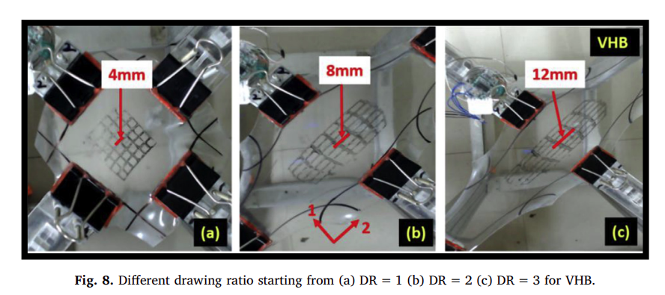
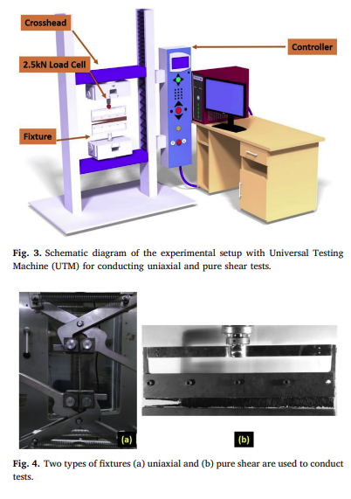
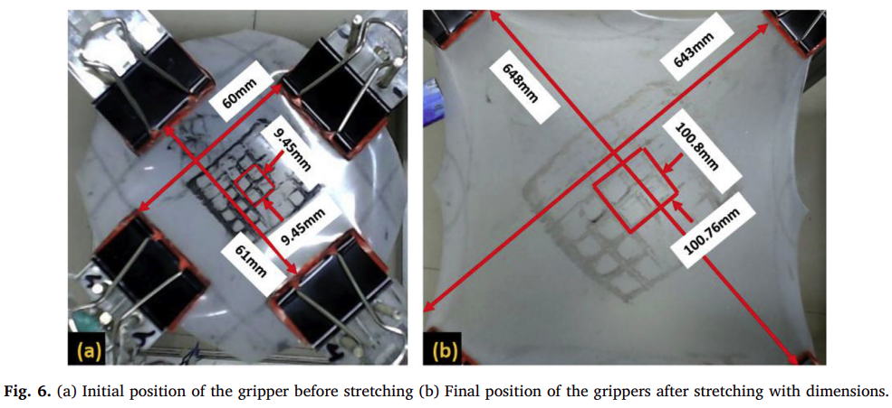
EXISTING MECHANISMS :
Traditional heavy setups for tensile stretching
Biaxial Planar Testing Device with Load Cell & multi-turn potentiometer sensors
Has uni/biaxial mode selection switch and computerised parametric selection
Limitations : Uses Non-compliant Fixtures , changes Orientation absurdly
Ref. Dilshad Ahmad, Sujit Kumar Sahu, and Karali Patra (2019)
Fracture toughness, hysteresis and stretchability of dielectric elastomers under equibiaxial and biaxial loading.
Polymer Testing, Volume 79, 106038.

Slide 6
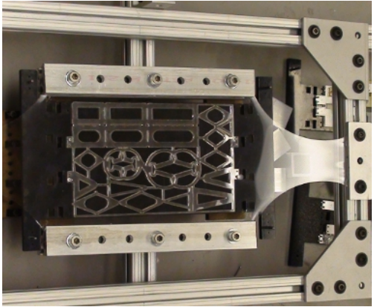
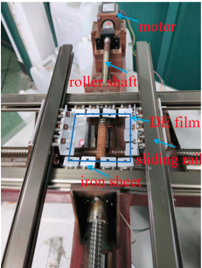
EXISTING MECHANISMS :
Manual biaxial stretching device based on slider setup
Limitations : Purely Manual, Uses Non-Compliant Fixtures, Orientation changes absurdly.
Semi-Automated equibiaxial pre-stretching roller-slider machine
Limitations : Not fully automated, Uses Non-Compliant Fixtures, Orientation changes absurdly , user has to rely on physical distance markings to achieve desired stretch.
Ref. Paul White, Stella Latscha, and Mark Yim (2014).
Modeling of a Dielectric Elastomer Bender Actuator.
Actuators, Volume 3, pp. 245–269.
Ref. Yuanlin Guan, Ziyin Liu et. al. (2026).
Research on design of soft gripper by dielectric elastomer actuator based on quadrangular star honeycomb support.
PLOS ONE, Volume 21, Issue 7, e0352654..

Slide 7
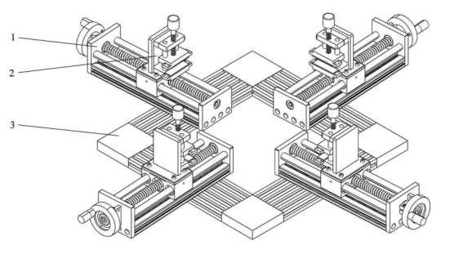
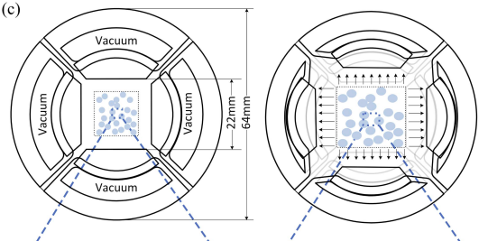
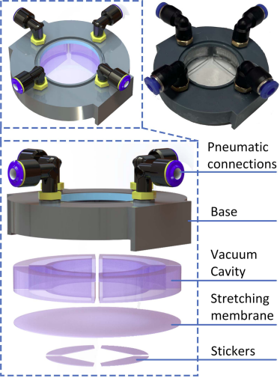
EXISTING MECHANISMS :
Manual biaxial stretching device based on roller slider setup
Limitations : Purely Manual, Uses Non-Compliant Fixtures, Orientation changes absurdly.
Vacuum based Biaxial Cell stretcher
Limitations : Needs constant power supply to keep it stretcehd, No mechanical lock, Orientation changes absurdly, Cannot give unequal biaxial stretch, Non uniform stretching.
Ref. Luo Z. et al. (2024).
A biaxial pre-stretching device and method for multi-shape dielectric elastomer samples.
Chinese Patent CN117825122B
Ref. Jue Wang, Aritra Chatterjee et. al. (2024).
Pneumatic Non-Equibiaxial Cell Stretching Device With Live-Cell Imaging
IEEE Transactions on Biomedical Engineering, 71(3), 820–830.

Slide 8
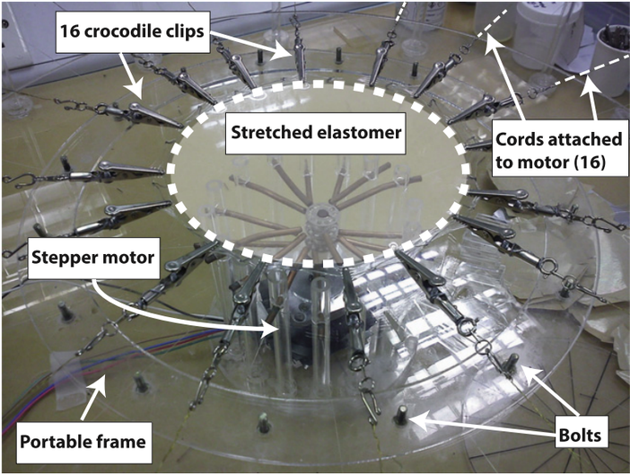
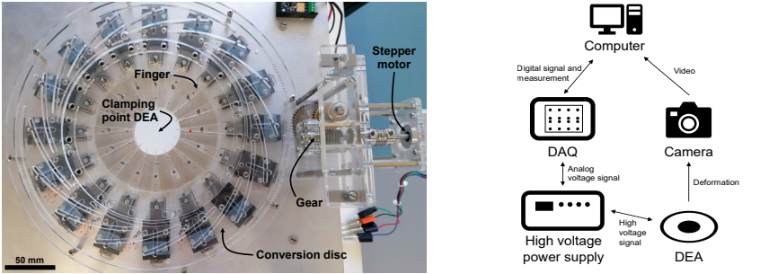
EXISTING MECHANISMS :
Clips based Radial stretcher
Limitations : Semi-automatic , manual locking
Radial Stretcher with Camera based Feedback
Paper not informative enough to conclude limitations.
Ref. Sze-Hsien Low and Gih-Keong Lau (2014).
Bi-axially crumpled silver thin-film electrodes for dielectric elastomer actuators.
Smart Materials and Structures, Volume 23, Issue 12, 125021.
Ref. Simon Holzer, Bhawnath Tiwari et. al. (2025).
Design and Characterization of an Equibiaxial Multi-Electrode Dielectric Elastomer Actuator.
Materials, Volume 18, 1693.

Slide 9
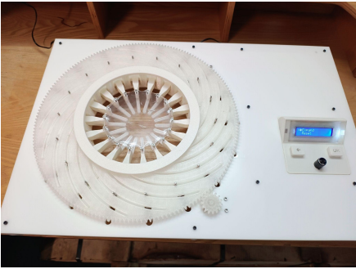
EXISTING MECHANISMS :
Fully Automated Radial Stretching Mechanism with self-locking and direct user input.
Ref. SMILE Lab IITI (2025)
Design and Development of an Automated Radial Stretching Mechanism for Elastomeric Membrane.
B.Tech. Project Report, IIT Indore, 2025
Manual → Motorized Testing Mechanisms → Feedback-Assisted
→ Semi-Automated Biaxial Stretching → Fully Automated Radial Stretching → Towards Fully Automated X–Y Biaxial Stretching Mechanism

Slide 10
OBJECTIVE :
To develop a fully automated biaxial stretching mechanism for DE.
Design Features :-
  Motorized actuation with controlled feedback
  Automated positioning
  Independent X–Y biaxial stretch control
  Direct User-defined stretch ratios as input
  Easy-to-operate Screen Menu with simple buttons
  Compact and integrated mechanism
  Reliable longer duration pre-stretch self locking without unnecessary power consumption
  Low-cost fabrication using 3D-printed components and electronics
  Compliant fixtures that keep the orientation of DE intact
  Unifrom Stretching & Repeatability
  Stretch-ratio resolution of 0.01x of original dimensions

Slide 11

WORK DONE :
DESIGN :
  Design idea & Parts measurements
  3D-modelling of all the components in Autodesk Fusion
  Assembly of parts & motion simulation in Fusion
  Tolarences testing & Design corrections
  3D printing of the complete parts to check functionality
HARDWARE :
  Understanding the Hardware requirements
  Finalising the electronic components
  Planning the signal flow
  Plotting the Final Circuit
AUTOMATION :
  Rough Arduino UNO code for UI, display & buttons
  Partial Arduino MEGA framework for motion control
  Established UNO <--> MEGA communication code

Slide 12
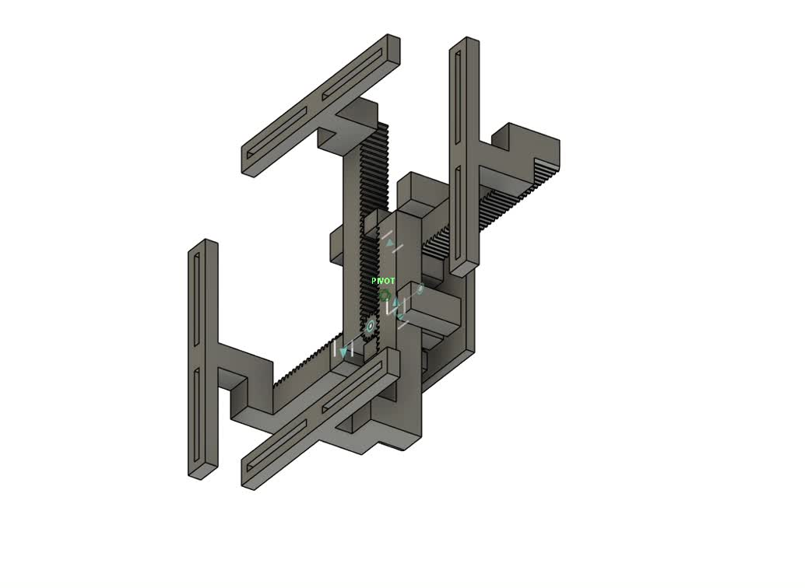
INITIAL DESIGNS :
Animation
Limitations :
4-pins mechanism
Higher stress concentration
Sqaure Nut-Bolt slider mechanism required at Pins
Frequent Neck design usage
Weak Resistance against Bending

Slide 13
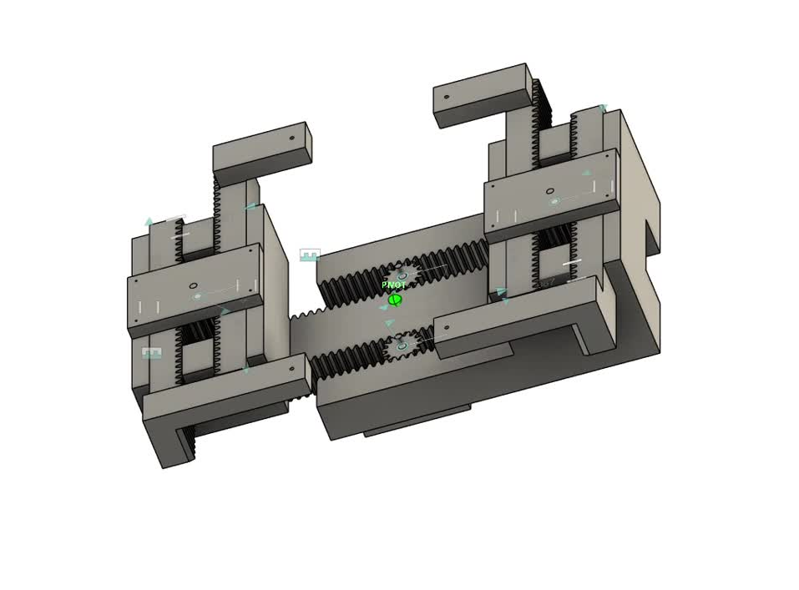
INITIAL DESIGNS :
Limitations :
4-pins mechanism
Higher stress concentration
Non-uniform rotary load distribution between 2 base gears
Requires a lot of constraining fences & blocks designs.

Slide 14
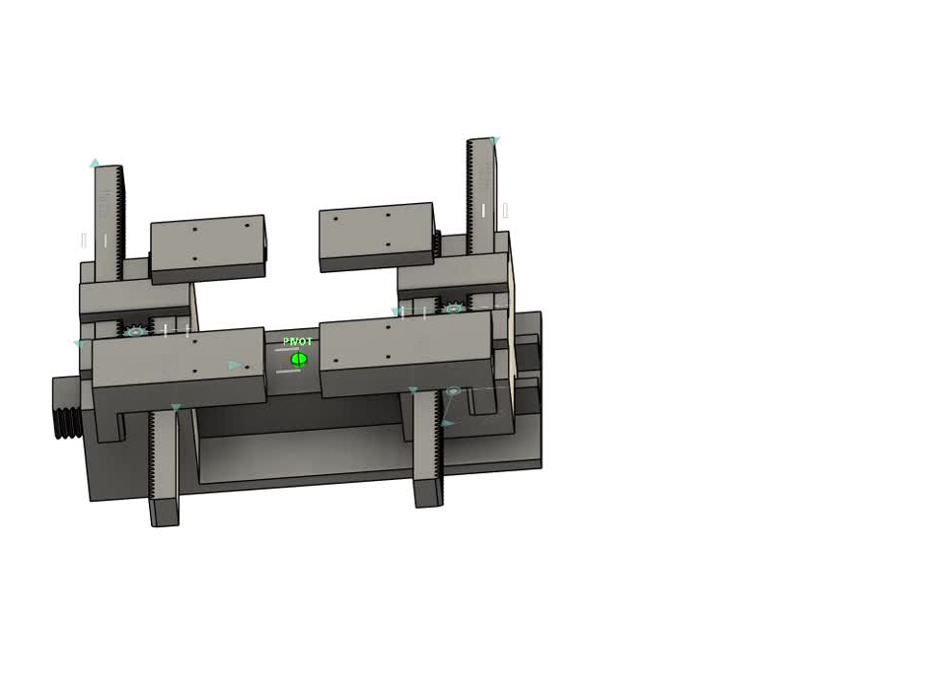
FINAL DESIGN :
Advantages :
8-pins mechanism
Uses scissor design to mediate between pins and elastomer.
Lower stress concentration & uniform stress distribution across the elastomer.
Compact and effective constraints in design.
Easier hardware integration

Slide 15
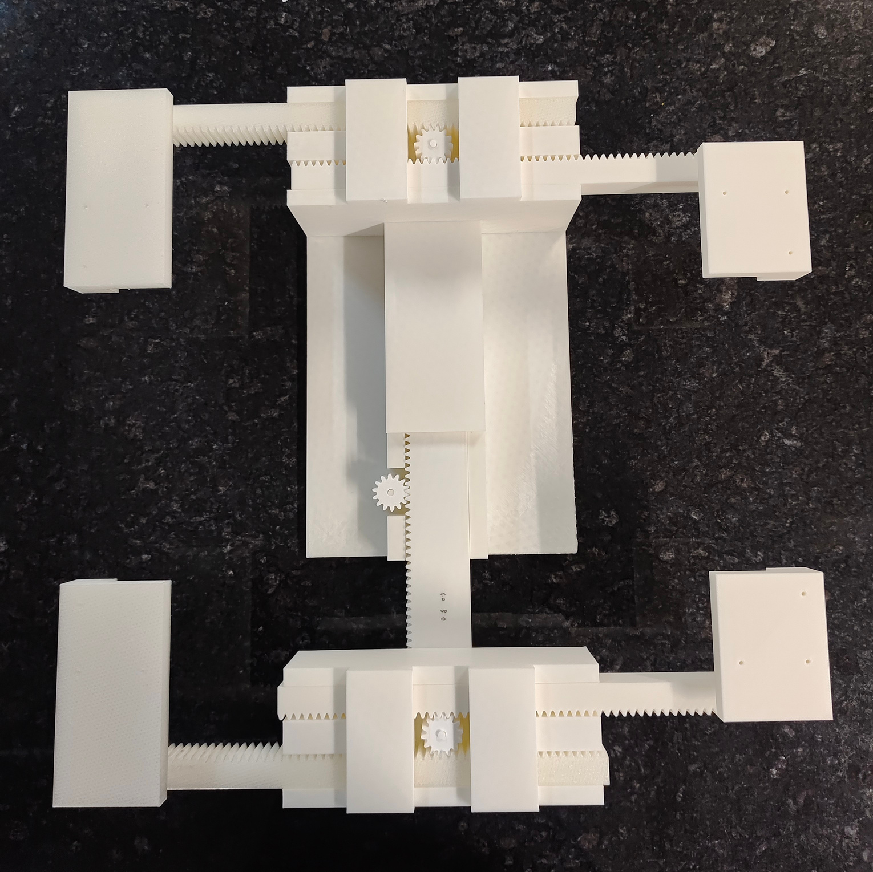
FINAL DESIGN :

Slide 16
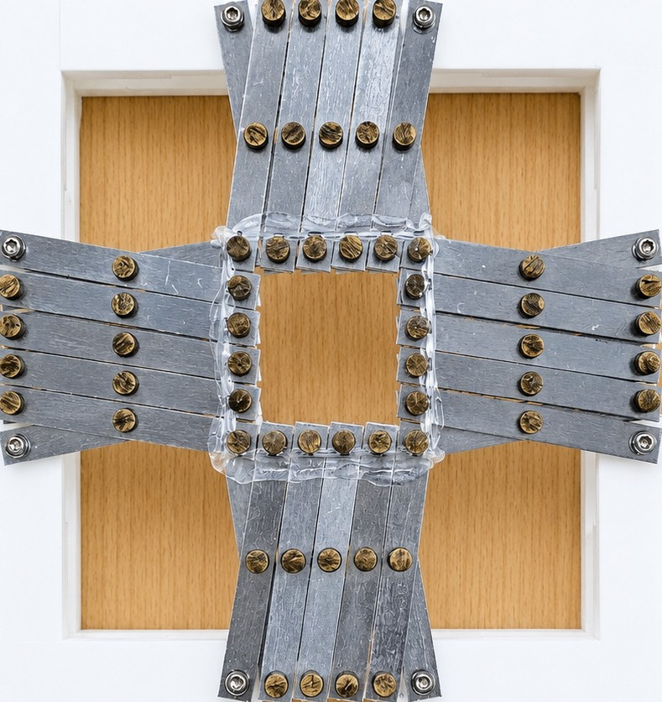
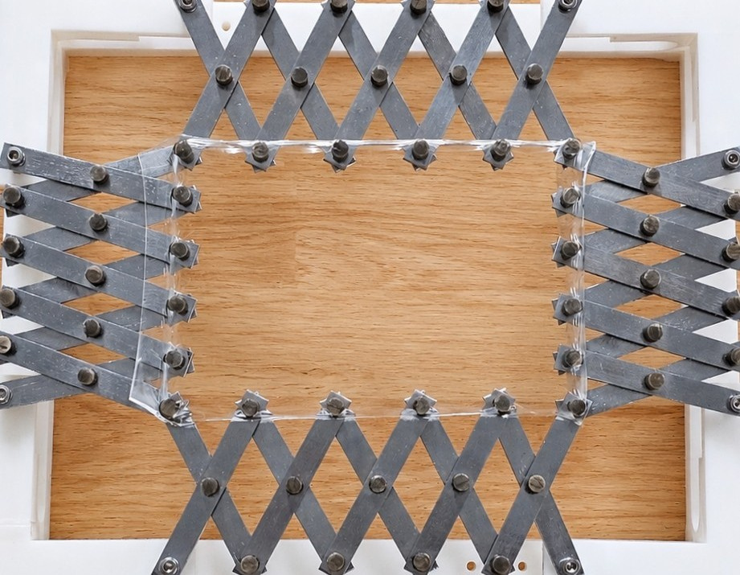
8-PIN SCISSOR MECHANISM :
Acts as a compliant fixture

Slide 17
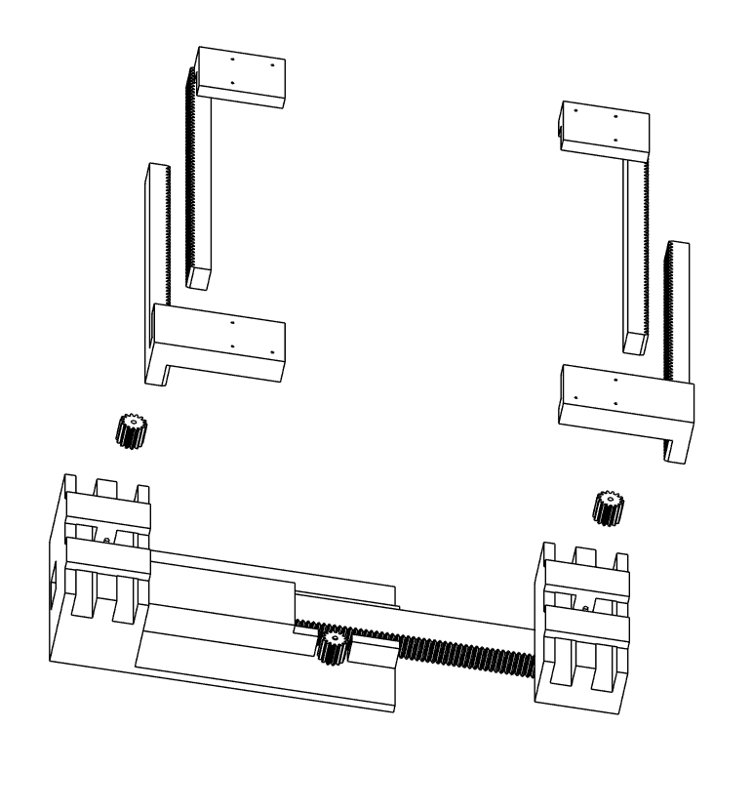
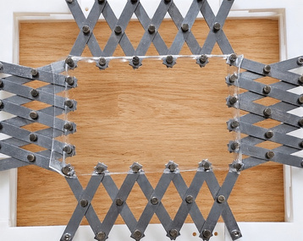
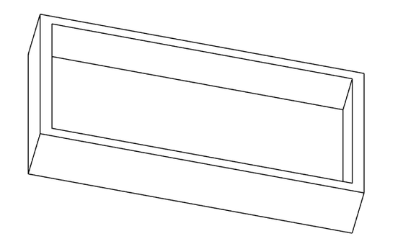
EXPLODED DESIGN VIEW :
Scissor Mechanism + DE
Rack Gear Mechanism
Cross L Racks
Y Direction
Central Gears 1 & 2 + Motors
Upper T Base + Source Gear with Motor + T Rack
X Direction
Lower Base for Hardware Integration

Slide 18
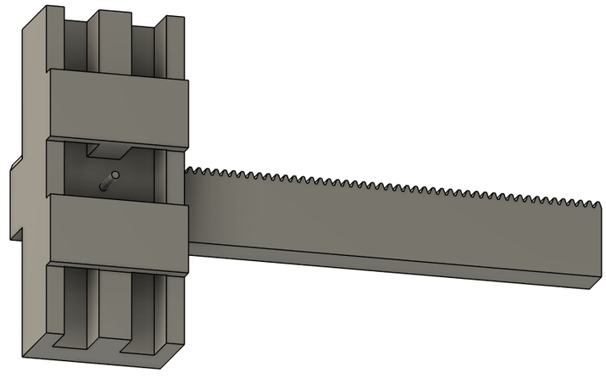
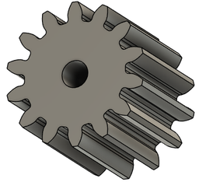
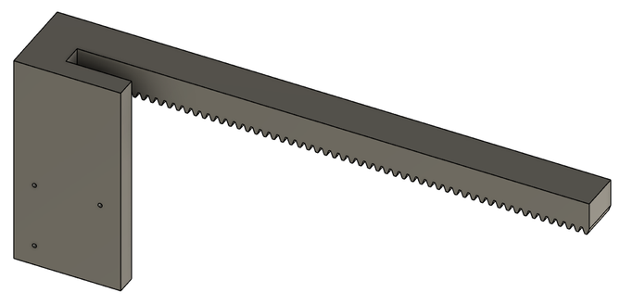
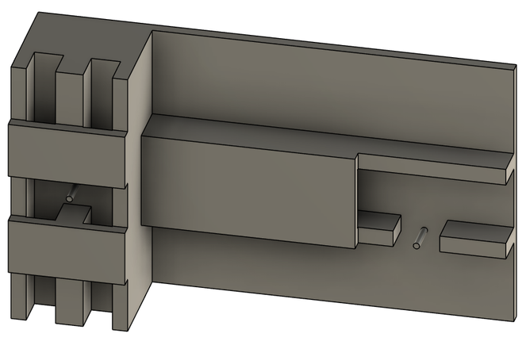
IMPORTANT DESIGN MEASUREMENTS :
Gears :
Module = 2
Pressure Angle = 20°
No. of Teeth = 28
Pitch radius = 14 mm
Thickness = 28 mm
T Rack :
Module = 2
Pitch = 2π = 6.28 mm
No. of Teeth = 66
Length = 419.44 mm
Width = 50 mm
Thickness = 30 mm
T Base :
Length = 410 mm
Width = 238 mm
Tolerances between :
Rack Teeth & Walls = 0.4 mm
2 Walls = 0.4 mm
Rack Teeth & Gear Teeth = 0.15 mm
Rest was designed accordingly
Cross L Racks :
Module = 2
Pitch = 2π = 6.28 mm
No. of Teeth = 63
Length = 400.6 mm
Width = 20 mm
Thickness = 30 mm

Slide 19
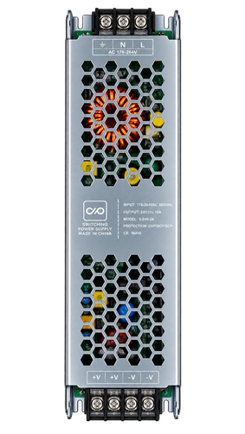


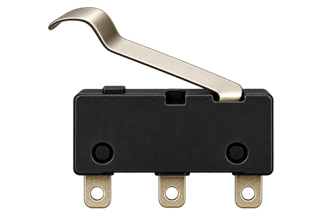
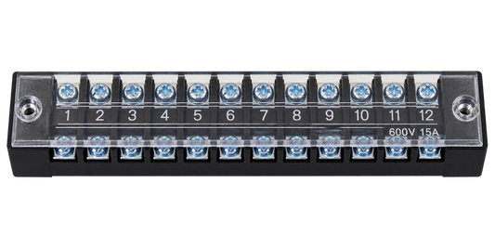
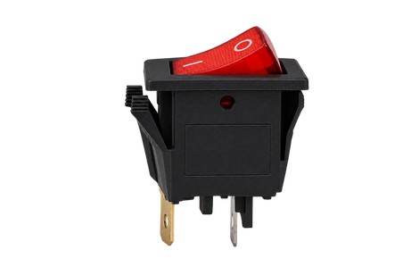
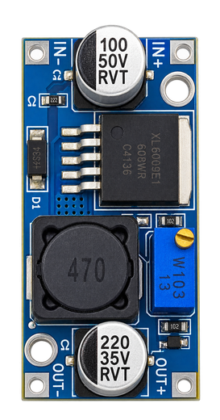
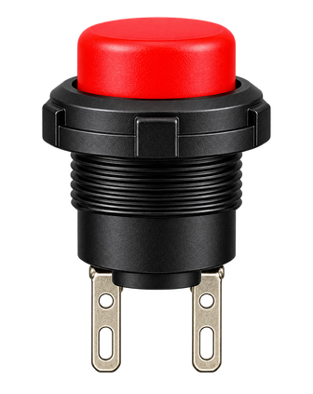
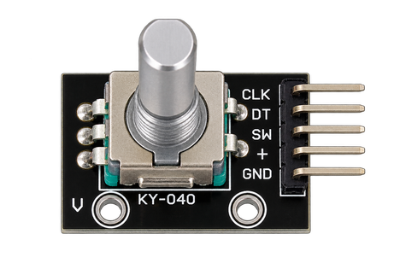
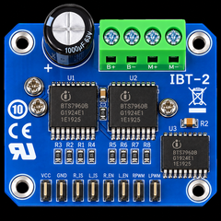
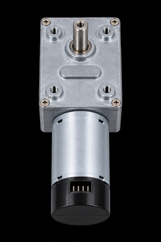

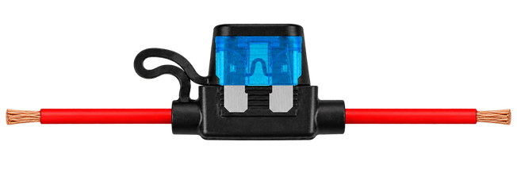
HARDWARE COMPONENTS :
12V SMPS Adapter
Arduino Uno
Arduino Mega
Limit Switch
(NO)
Terminal Block
Switch
LCD
Display
5V Buck
Converter
Rotary Encoder
Motor
Driver
DC Worm Gear Motor
with encoder
Fuse
Back Button

Slide 20

BLOCK DIAGRAM :
AC Power Source
12V SMPS
5V Buck Converter
Electrical Power
Electrical Signal
Mechanical Transmission
Microcontrollers
(Uno Mega)
Motor Driver
Motor + Encoder
Limit Switch
Mechanism
Gear Box
LED Display
Back
Button
Rotary Encoder

Slide 21
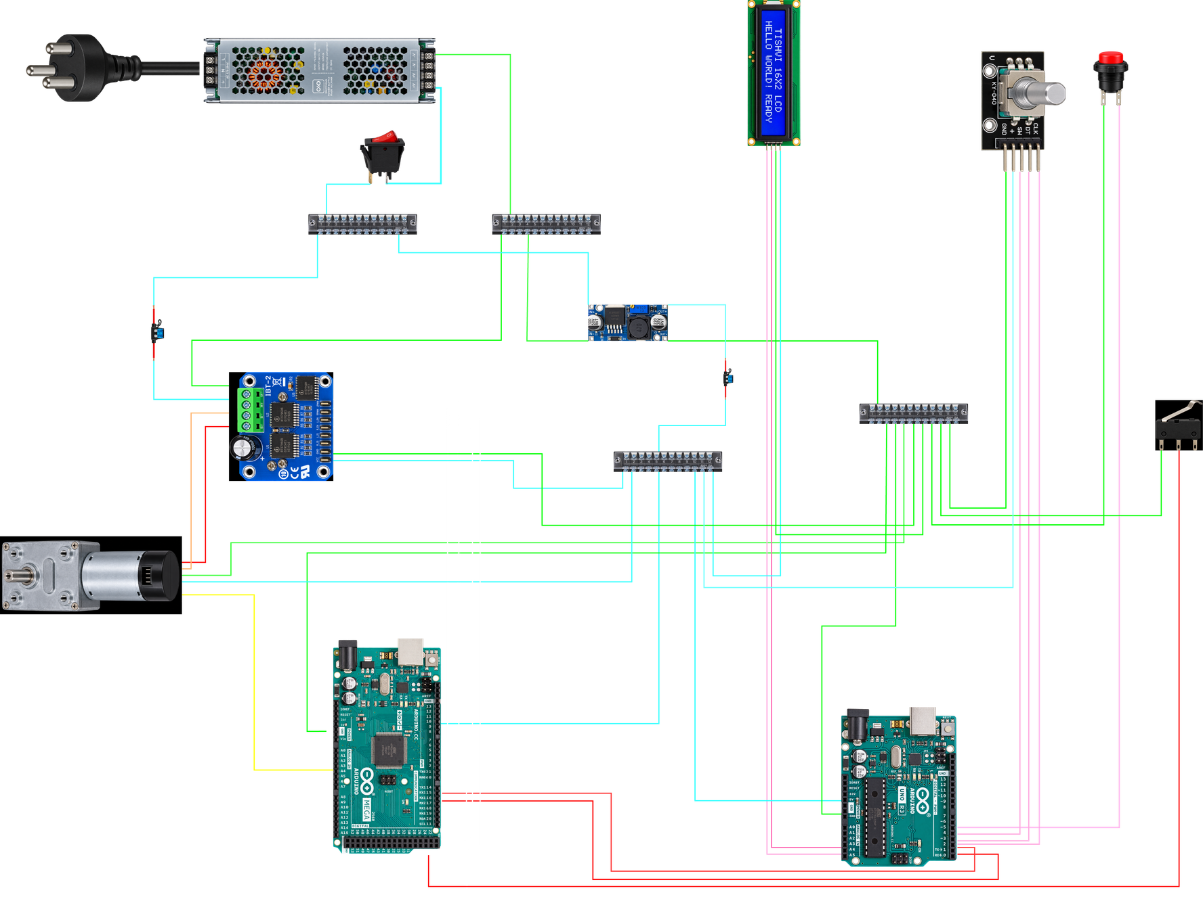
CIRCUIT DIAGRAM :

Slide 22
FUTURE WORK :
Hardware Testing
Motor & Encoder Caliberation
Design Modification
Final Parts Fabrication
Hardware Integration
Wire Connections
Model Testing and Rectifications

Slide 23
REFERENCES :
[1.] Bo Li, Hualing Chen, Junhua Qiang, Shulin Hu, Zicai Zhu and Yongquan Wang (2011)
Effect of mechanical pre-stretch on the stabilization of dielectric elastomer actuation.
Journal of Physics D: Applied Physics, 44, 155301.
DOI: 10.1088/0022-3727/44/15/155301
[2.] Liang Jiang, Anthony Betts, David Kennedy and Stephen Jerrams (2016)
Eliminating electromechanical instability in dielectric elastomers by employing pre-stretch.
Journal of Physics D: Applied Physics, 49, 265401.
DOI: 10.1088/0022-3727/49/26/265401
[3.] Deepak Kumara, Somnath Sarang (2020)
Pre-stretching effect modeling of a dielectric elastomer under the electrical loading condition.
Materials Today: Proceedings, 24, 290–297.
DOI: 10.1016/j.matpr.2020.04.278
[4.] Danh Quang Tran , Jin Li , Fuzhen Xuan and Ting Xiao (2018)
Viscoelastic effects on the actuation performance of a dielectric elastomer actuator under different equal, un-equal biaxial pre-stretches. *
Materials Research Express, 5, 065303.
DOI: 10.1088/2053-1591/aac673
[5.] Ajeet Kumar , Dilshad Ahmad , Karali Patra (2018)
Dependence of Actuation Strain of Dielectric Elastomer on Equi-biaxial, Pure Shear and Uniaxial Modes of Pre-stretching. *
IOP Conference Series: Materials Science and Engineering, 310, 012104.
DOI: 10.1088/1757-899X/310/1/012104

Slide 24
THANK YOU !

